Slide 1
natural language processing
Lecture 3 – language modeling

Slide 2
Count! N-gram language models
Notes:
We going to speak about the language models first, and then about the models that works with sequences of words.
For example part-of-speech tagging or named entity recognition.
All those tasks are building blocks for NLP applications. And they are useful.

Slide 3

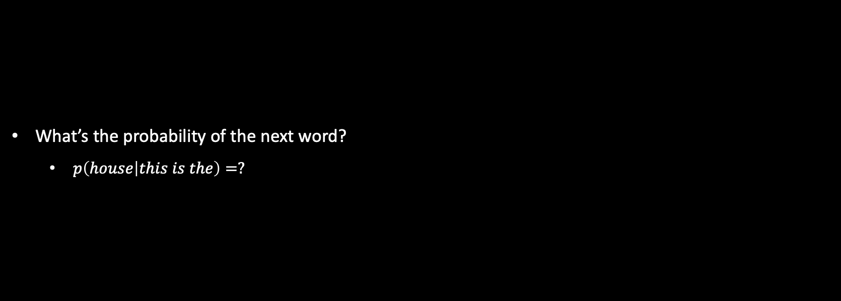
Language modeling
What’s the probability of the next word?
$p\left(house | this is the\right)=?$
Notes:
Imaging you see some beginning of a sentence like This is the … house sounds nice, did sound not meaningful. You have some intuition. So how do you know this? Well, you have written books, you have seen some text so this obvious for you.
Can I build similar intuition for computers? Well we can try, so we can try to estimate probability of the next words, given the previous words. But to do this we need some dat.

Slide 4
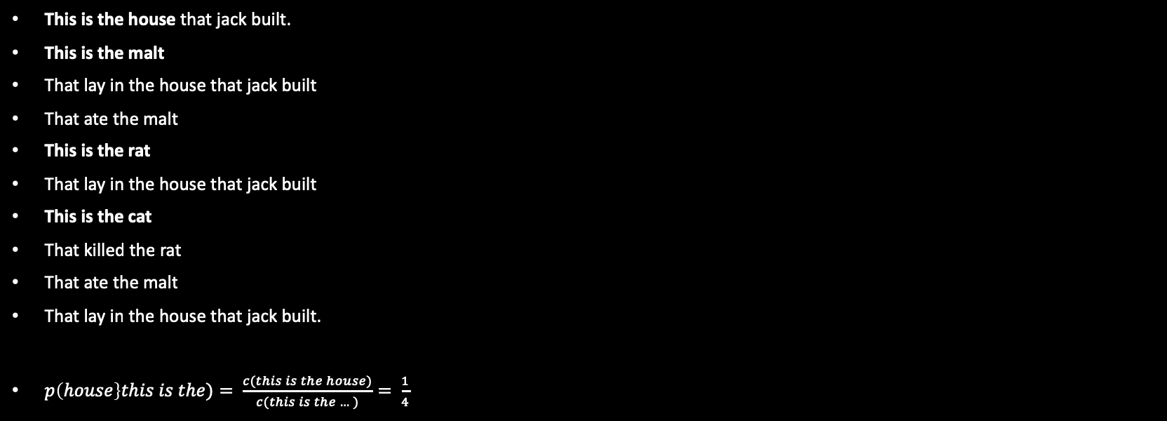
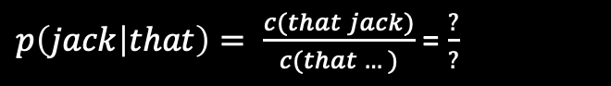
Toy corpus
This is the house that jack built.
This is the malt
That lay in the house that jack built
That ate the malt
This is the rat
That lay in the house that jack built
This is the cat
That killed the rat
That ate the malt
That lay in the house that jack built.
$p\left(house\right\}this is the)= \frac{c(this is the house)}{c(this is the …)}= \frac{1}{4}$
$p\left(jack | that\right)= \frac{c(that jack)}{c(that …)}$ = $\frac{?}{?}$
Notes:
This is the good toy corpus about house that jack built, and let’s try to use it to estimate the probability of house, given this is the.
There are four interesting fragments here and only one of them is exactly what we need. This is the house. So it means the probability is 1 of 4.
These pieces of text are n-grams, n-gram is a sequence of n words. So we can speak about 4-grams here. We can also speak about unigrams, bigrams, trigrams, etc.
4/10
Why do we need this? How we can use this?

Slide 5
Where do we need LM?
Suggestions in massagers
Spelling correction
Machine translation
Speech recognition
Handwriting recognition
…
Notes:
It been used everywhere.
Automatically reply by gmail.

Slide 6
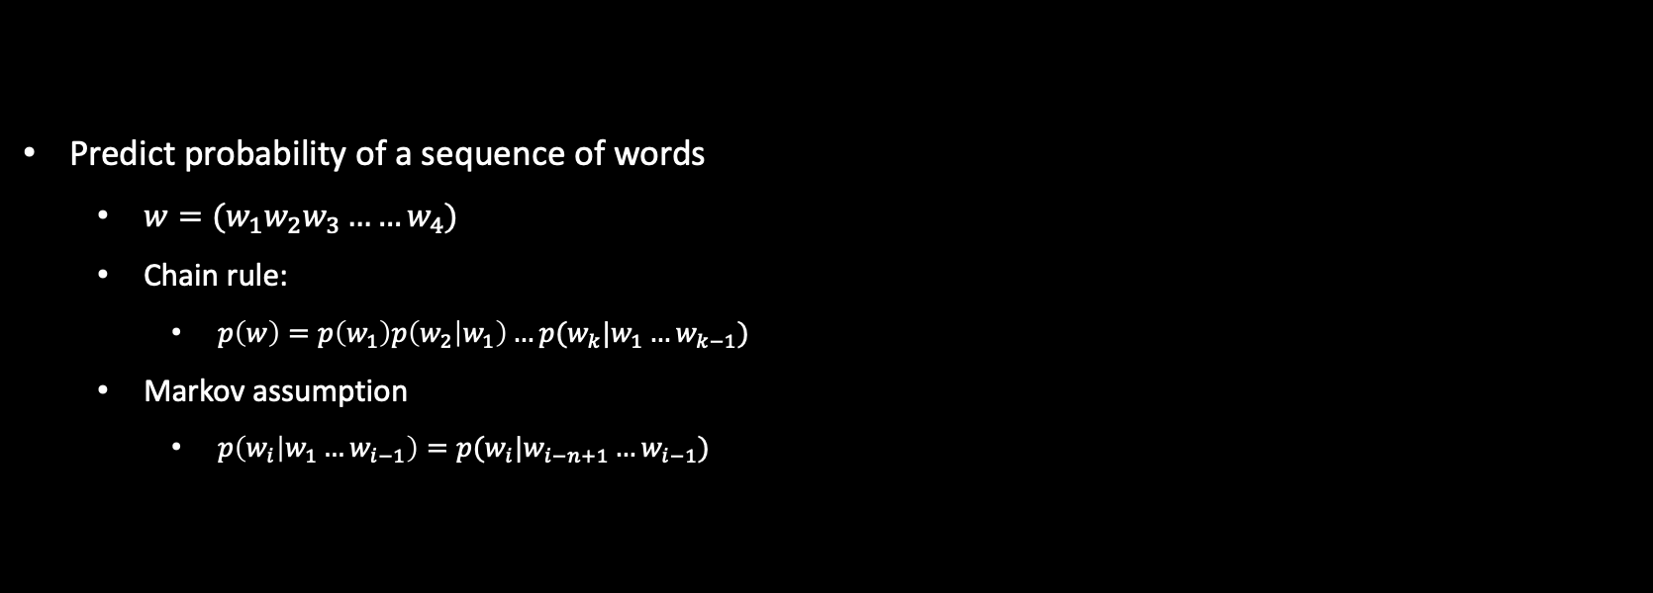
Let’s do some math
Predict probability of a sequence of words
$w=(w_{1}w_{2}w_{3}……w_{4})$
Chain rule:
$p\left(w\right)=p\left(w_{1}\right)p\left(w_{2} | w_{1}\right)…p(w_{k}|w_{1}…w_{k−1})$
Markov assumption
$p\left(w_{i} | w_{1}…w_{i−1}\right)=p(w_{i}|w_{i−n+1}…w_{i−1})$
Notes:
Let’s do some method to deal with small pieces of sequence.
We are here to estimate the probability of the keywords, there is a chain rule which take p of first word, the p of ½, and so on to get the estimate, but the last one still complicated because the condition is too long, can we get rid of it,
Markov assumption says you shouldn’t care about all the history, should just forget it, just last n-1 terms.

Slide 7
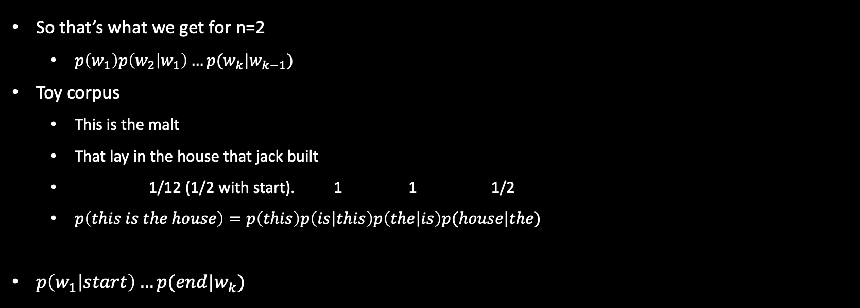
Bigram language model
So that’s what we get for n=2
$p\left(w_{1}\right)p\left(w_{2} | w_{1}\right)…p(w_{k}|w_{k−1})$
Toy corpus
This is the malt
That lay in the house that jack built
1/12 (1/2 with start). 1 1 1/2
$p\left(this is the house\right)=p\left(this\right)p\left(is | this\right)p\left(the | is\right)p(house|the)$
$p\left(w_{1} | start\right)…p(end|w_{k})$
Notes:
There are 2 problems here.
So first, let's look into the first word here and
the probability of this first word.
So the first word can be This or
That in our toy corpus.
But it can never be malt or something else.
Well, maybe we should use this.
So maybe we should not spread the probability
among all possible words in the vocabulary.
But we should just stick to those that are likely to be in the first spot.
6:17And we can do this.
Let us just condition our first words on a fake start token.
So let's add this fake start token in the beginning.
And then we will get the probability = 1/2 for the first place,
right, because we have either the This or That.
So it can be helpful.
We can add fake end term as well.

Slide 8
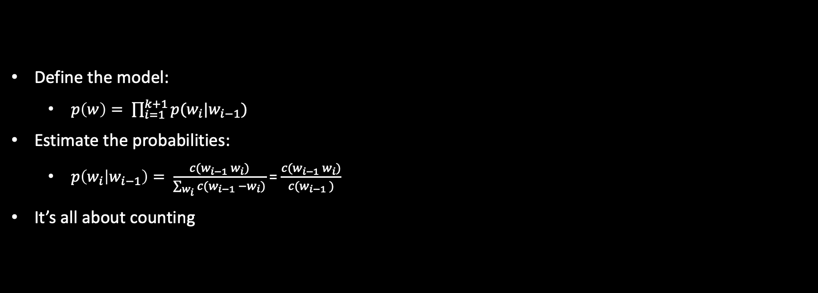
Resume: bigram language model
Define the model:
$p\left(w\right)= \prod_{i=1}^{k+1}{p(w_{i}|w_{i−1})}$
Estimate the probabilities:
$p\left(w_{i} | w_{i−1}\right)= \frac{c(w_{i−1} w_{i})}{\sum_{w_{i}}{c(w_{i−1} −w_{i})}}$ = $\frac{c(w_{i−1} w_{i})}{c(w_{i−1} )}$
It’s all about counting
Notes:
Hope you can understand the model in mathmaticty

Slide 9
perplexity
is our model surprised with a real text

Slide 10
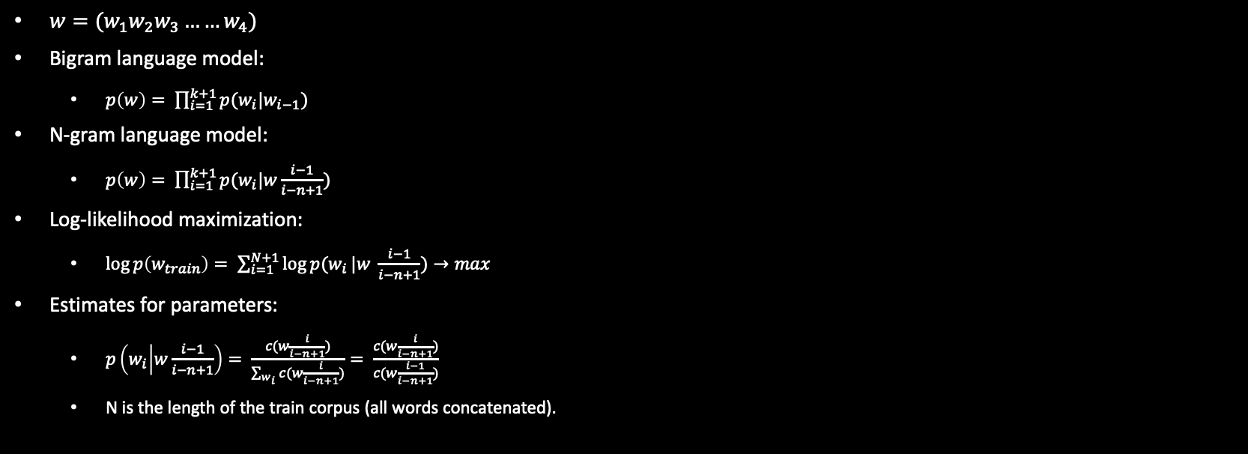
How to train n-gram models
$w=(w_{1}w_{2}w_{3}……w_{4})$
Bigram language model:
$p\left(w\right)= \prod_{i=1}^{k+1}{p(w_{i}|w_{i−1})}$
N-gram language model:
$p\left(w\right)= \prod_{i=1}^{k+1}{p(w_{i}|w\frac{i−1}{i−n+1})}$
Log-likelihood maximization:
$\log{p\left(w_{train}\right)= \sum_{i=1}^{N+1}{\log{p(w_{i}}|w \frac{i−1}{i−n+1}})→max}$
Estimates for parameters:
$p\left(w_{i} | w\frac{i−1}{i−n+1}\right)= \frac{c(w\frac{i}{i−n+1})}{\sum_{w_{i}}{c(w\frac{i}{i−n+1})}}= \frac{c(w\frac{i}{i−n+1})}{c(w\frac{i−1}{i−n+1})}$
N is the length of the train corpus (all words concatenated).
Notes:
This is what you have already seen in the end of our previous slides.
So just to remind,
we have some sequences and we are going to predict the probabilities of these sequences.
So we learnt that with bigger language model,
you can factorize your probability into some terms.
So these are the probabilities of the next word,
given the previous words.
Now, take a moment to see whether everything is okay with the indices on this slide.
Well, you can notice that i can be equal to 0 or to k plus 1,
and it goes out of range of our sequence.
But that's okay because if you remember our previous video,
we discussed that we should have some fake tokens
in the beginning of the sequence and in the end of the sequence.
So this I equal to 0 and to k plus 1 will be exactly these fake tokens.
So everything good here
This is just a generalization.
This is n-gram language model.
So the only difference here is that the history gets longer.
So we condition not only on the previous words but on
the whole sequence of n minus 1 previous words.
So just take a note to these denotions here.
This is just a brief way to show that we have a sequence of n minus one words
This is just a brief way to show that we have a sequence of n minus one words.
Great. We have some intuition how to estimate these probabilities.
So you remember that we can just count some n-grams and normalize these counts.
But, now, I want to give you some intuition,
not only just intuition but mathematical justification.
Well, we have some probabilistic model,
and we have some data.
And we want to learn the parameters of this model.
What do we do in this case?
So what you do is likelihood maximization by W train,
and you note here my train data.
So this is just a concatenation off all the training sequences that I have,
giving a total of big M tokens.
Now, I take the logarithm of
this probability because it is easier to optimize the sum of logarithms,
rather than the product of probabilities.
And I just write down the probability of my data according to my model.
Okay? So if I'm not too lazy,
I would take the derivatives of this likelihood,
and I would also think about constraints,
such as normalization and non-negativity of my parameters.
And I will derive to exactly
these formulas that you will see in the bottom of this slide.
So these counts and normalization of these counts have mathematical justification,
which is likelihood maximization.
So this is just the likelihood maximization estimates.
Awesome. We now can train our language model.

Slide 11
Generated Shakespeare
Unigrams:
To him swallowed confess hear both. Which. Of save on trail for are ay device and rote life have. Every enter now severally so, let. Hill he late speaks; or! A more to leg less first you entry.
Bigrams:
What means, sir. I confess she? Then all sorts, he is trim, cptain, why dost stand forth they canopy, forsooth; he is this palpable hit the Kong henry. Live king. Folow. What we, hath got s she that I rest and send to scold and nature bankrupt, nor the first gentleman?

Slide 12
Generated Shakespeare
3-grams:
Sweet prince, Falstaff shall die. Harry of Monmouth’s grave. This shall forbid it should be branded, if renown made it empty. What is’t that cried? Indeed the duke; and had a very good friend. Fly, and will rid me these news of price. Therefore the sadness of parting, as they say, ’tis done.
4-grams:
King Henry. What! I will go seek the traitor Gloucester. Exeunt some of the watch. A great banquet serv’d in; Will you not tell me who I am? It cannot be but so. Indeed the short and the long. Marry, ’tis a noble Lepidus. They say all lovers swear more performance than they are wont to keep obliged faith.

Slide 13
Which model is better?
The best n might depend on how much data you have:
Bigrams might be not enough
7-grams might never occur
Extrinsic evaluation
Quality of a downstream task: machine translation speech recognition, spelling correction…
Intrinsic evaluation:
Hold-out(text) perplexity
Notes:
How would you choose the best n here?
Do you have any intuition or maybe the procedure to find the best n for your model?
Well, for this case,
I would say that 5-gram models usually are the best for language modeling,
but it is really, really dependent on your data and on your certain task.
So the general question is how do we decide which model is better?
How do we evaluate and compare our models?
So one way to go is to do extrinsic evaluation.
So, for example, we can have
some machine translation system or speech recognition system,
any final application, and we can measure the quality of this application.
This is a good way, but sometimes we do not have
time or resources to build the whole application.
Okay? So we want also to have some intrinsic evaluation,
which means just to evaluate the language model itself.
And one way that people use all the time is called perplexity.
It is called holdout perplexity.
Why? Because we have some data, and usually,
we held out some data to compute perplexity later.
So this is holdout data.
This is just other words to say that we need some transplit and test split.

Slide 14
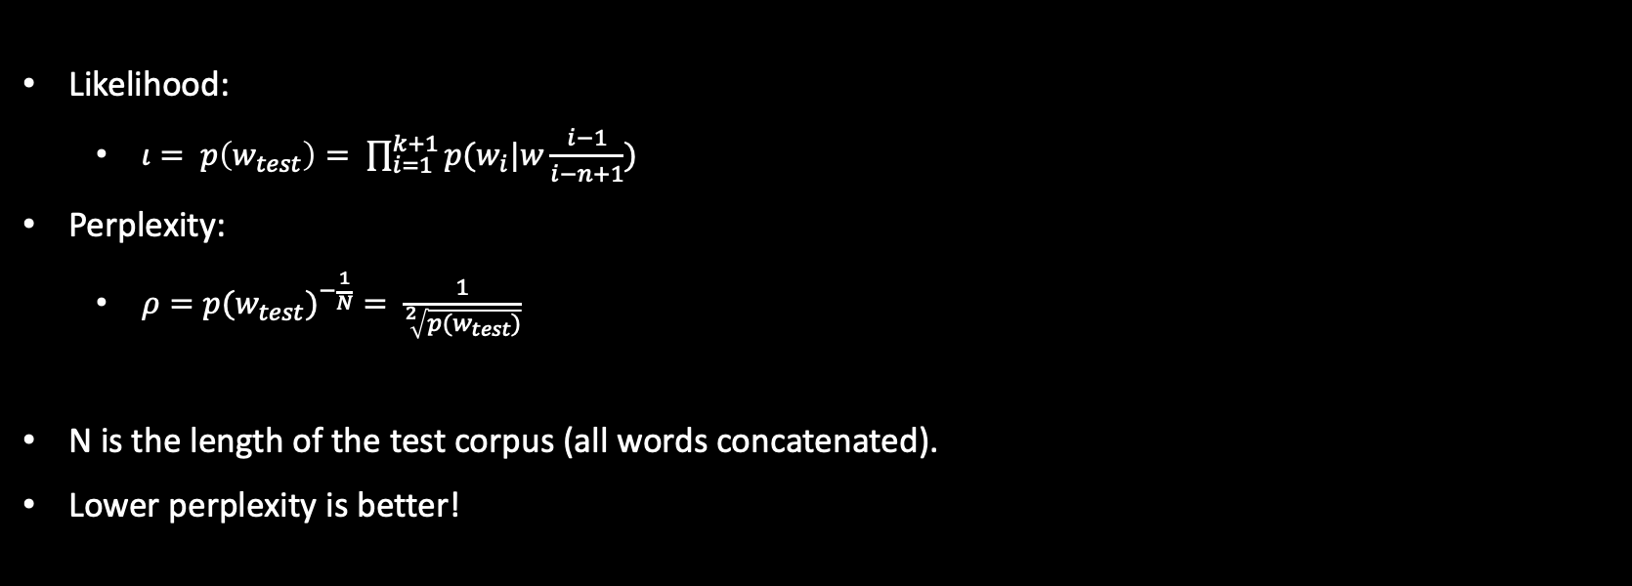
Evaluate the model on the test set
Likelihood:
$ι= p\left(w_{test}\right)= \prod_{i=1}^{k+1}{p(w_{i}|w\frac{i−1}{i−n+1})}$
Perplexity:
$ρ={p(w_{test})}^{−\frac{1}{N}}= \frac{1}{\sqrt[2]{p(w_{test})}}$
N is the length of the test corpus (all words concatenated).
Lower perplexity is better!
Notes:
So what is perplexity?
Well, you know what is the likelihood.
So, here, I just write down the likelihood for my test data,
and perplexity is super similar.
So perplexity has just likelihood in the denominator.
You can be curious why exactly this formula.
Well it is really related to entropy,
but we are not going into details right now.
So the thing that we need to know is that the lower perplexity is, the better.
Why? Because the greater likelihood is, the better.
So the likelihood shows whether our model is surprised with our text or not,
whether our model predicts exactly the same test data that we have in real life.
So perplexity has also this intuition.
And, remember, the lower perplexity, the better

Slide 15
smoothing
What if we see new n-grams?

Slide 16
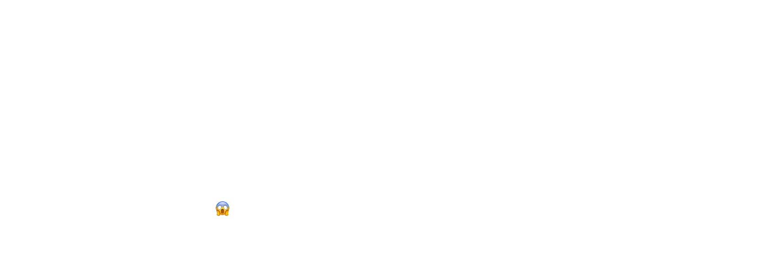
Zero probabilities for test data
Toy train corpus
This is the house that jack built.
Toy test corpus
This is jack
What’s the perplexity of the Bigram LM?
0 and 0, so $ρ=inf.$ 😱
Notes:
So the language is really variative.
It means that if we train a model on a train data,
it is very likely that whether we apply this model to the test data,
we will get some zeros.
For example, some bigrams will not occur in the test data.
So, what can we do about those zeros?
Could we probably just substitute them by ones?
Well, actually, we cannot do this.
And the reason is that in this way,
you will not get a correct probability distribution,
so it will not be normalized into one.

Slide 17
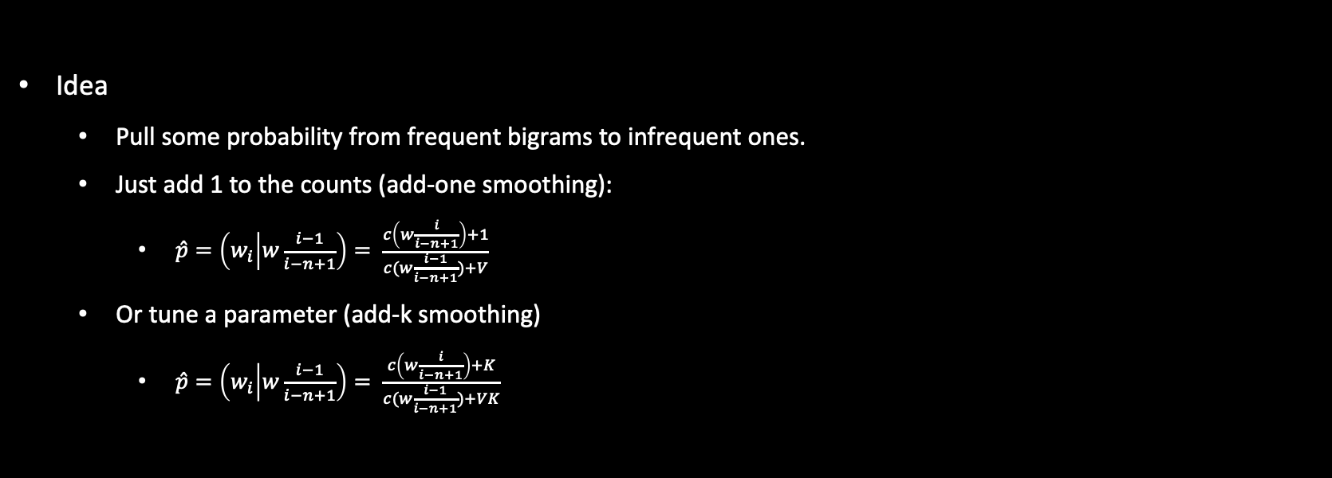
Laplacian smoothing
Idea
Pull some probability from frequent bigrams to infrequent ones.
Just add 1 to the counts (add-one smoothing):
$\hat{p}=\left(w_{i} | w\frac{i−1}{i−n+1}\right)= \frac{c\left(w\frac{i}{i−n+1}\right)+1}{c(w\frac{i−1}{i−n+1})+V}$
Or tune a parameter (add-k smoothing)
$\hat{p}=\left(w_{i} | w\frac{i−1}{i−n+1}\right)= \frac{c\left(w\frac{i}{i−n+1}\right)+K}{c(w\frac{i−1}{i−n+1})+VK}$
Notes:
We can add one to all the accounts,
even those that are not zeros.
And then, we will add V,
the number of words in our vocabulary, to the denominator.
In this way, we will get correct probability distribution and it will have no zeroes.
Now, what we have just done,
so the idea is very simple.
We need to somehow pull the probability mass
from the frequent n-grams to infrequent ones.
And this is actually the only idea about all smoothing techniques.
So, in the rest of the video,
we will discover what is the best way to pull the probability
mass from frequent n-grams to infrequent n-grams.
One rather simple approach as well would be to add not one but
some k. And we can tune this constant using our test data.
It will be called, Add-k smoothing.
All these approaches are sometimes called Laplacian smoothing,
which just may be the easiest and the most popular smoothing.

Slide 18
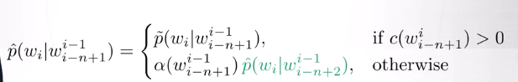
Katz backoff
Problem
Longer n-grams are better, but data is not always enough
idea
Try a longer n-gram and back off to shorter if needed
Notes:
Let us try to see something more complicated.
So, sometimes we would like to use longer n-grams.
It would be nice to use them but we might have not enough data to do this.
So, the idea is,
what if we try to use longer n-grams first, and then,
if we have not enough data to estimate the counts for them,
we will become not that greedy and go for shorter n-grams?
Katz backoff is an implementation of this idea.
So, let us start for example,
with a five gram language model.
If the counter is greater than zero,
then awesome, go for it.
If it's not greater than zero,
then let us be not that greedy and go for a full gram language model.
And again, if the counter is greater than zero,
then we go for it,
else we go to trigram language model.
So that is simple but I have a question for you.

Slide 19
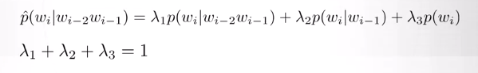
Interpolation smoothing
Idea
Let us have a mixture of several n-gram models
Example for a trigram model:
The weights are optimized on a test (dev) set
Optionally they can also depend on the context
Notes:
The same idea can be implemented in a different way.
So, the Interpolation smoothing says that,
let us just have the mixture of all these n-gram models for different end.
For example, we will have unigram,
bigram and trigram language models and we will weight them with
some lambda coefficients and this lambda coefficients will sum into one,
so we will still get a normal probability.
And how can we find this lambdas?
Well, we can just tune them using some test or some development set,
if we are afraid to get or fit it.
Optionally, those lambdas can also depend on
some context in their more sophisticated schemes.

Slide 20
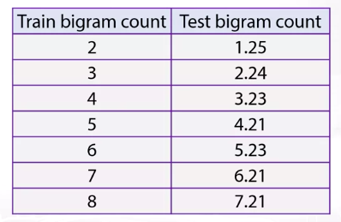
Absolute discounting
Idea
Let’s compare the counts for bigrams in train and test sets
Experiment (Church and Gale, 1991)
Subtract 0.75 and get a good estimate for the test count!
Notes:
Absolute discounting.
Just to recap, the motivation for all our methods in this video is
to pull the probability mass from frequent n-grams to infrequent n-grams.
So, to what extent should we pull this probability mass?
The answer for this question can be given by a nice experiment which was held in 1991.
Let us stick to bigrams for now,
and let us see that if you count the number of
bigrams in your training data and after that,
you count the average number of the same bigrams in the test data.
Those numbers are really correlated.
So, you can see that if you're just subtract 0.75 from your train data counts,
you will get very good estimates for
your test data and this is a little bit magical property.
So, this is just a property of the language that we can try to use.
The way that we use it,
is let us subtract this D which is 0.75 or maybe,
which is tuned using some test data that is subtracted
from our counts to model the probability of our frequent n-grams.
So, this is how we pull the mass and 0.75 is this extent of pull

Slide 21
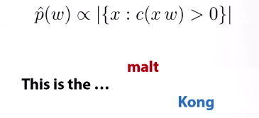
Kneser-ney smoothing
Idea:
The unigram distribution captures the word frequency
We need to capture the diversity of contexts for the word
Probably, the most popular smoothing technique
Notes:
Now, to give the probability to infrequent terms,
we are using here unigram distribution.
So in the right hand side,
you'll see some weight,
that makes sure that normalization is fine and the unigram distribution.
Now, can we do maybe something better than just a unigram distribution there?
And this is the idea of the Kneser-Ney smoothing.
So, let us see this example.
This is the malt or this is the Kong.
So, the word Kong might be even more popular than the word malt but the thing is,
that it can only occur in a bigram Hong Kong.
So, the word Kong is not very variative
in terms of different contexts that can go before it.
And this why, we should not prefer this word here to continue our phrase.
On the opposite, The word malt is not that popular
but it can go nicely with different contexts.
So, this idea is formalized with the formula in the top of this slide.
Let us have the probability of the words proportional
to how many different contexts can go just before the word.
So, if you take your absolute discounting model and instead of
unigram distribution have these nice distribution you will get Kneser-Ney smoothing.

Slide 22
Hidden markov models
Notes:
we are going to discuss sequence tagging task.
We'll start with some examples and then
investigate one model that can be used to solve it.
It will be called Hidden Markov Model

Slide 23
Sequence labeling
Problem
Given a sequence of tokens, infer the most probable sequence of labels for these tokens.
Examples
Part of speech tagging
Named entity recognition
Notes:
So the problem is as follows.
You are given a sequence of tokens,
and you would like to generate a sequence of labels for them.
The examples would be part of speech tagging, named entity recognition,
or semantic slot filling that we have briefly seen in introduction

Slide 24
Example: part-of-speech tagging
Tokens are words, and labels are PoS tags.
PRON. VERB. DET. PROPN. NOUN
I. Saw. A. Heffalump today
Notes:
Now, for example, I am given a sequence of words,
and they want to produce part-of-speech tags like here.
For example, saw is that the verb and I is the pronoun and so on.
There are different systems to list
all possible tags and different systems to
decide what are important tags and not Important tags

Slide 25
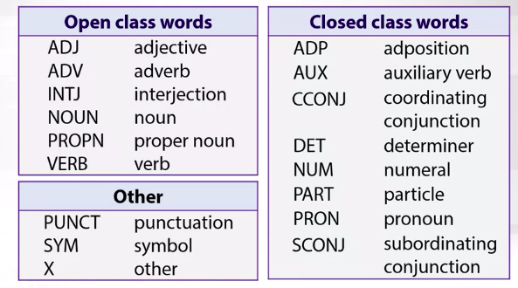
Pos tags from universal dependencies project
Notes:
One system is here,
and you can see that there are some open class words and
closed class words and some other labels.
For example, we have also here some punctuation and
symbols for punctuation if we see it in the texts

Slide 26
Example: named entity recognition
Once upon a tie, a very long time ago now, about last Friday, Winnie-the-Pooh lived in a forest all by himself under the name of Sanders
Notes:
Another example would be named entity recognition.
So, here, I have a sequence and
last Friday or Winnie-the-Pooh would be some named entities.
Sometimes we really need to find them in the texts and use them as features,
or maybe we need them to generate answer to some question

Slide 27
Type of named entities
Any real-world object which may have a proper name
Persons
Organizations
Locations
…
Also named entities usually include
Dates and times
Units
Amounts
Notes:
What kind of named entities can we see?
First of all, it would be some persons or
organization names or locations but not only them.
For example, we can also have dates and the units
and any other entities that you see in the texts

Slide 28
Approaches to sequence labeling
Rule-based models (example: EngCG tagger)
Separate label classifiers for each token
Sequence models (HMM, MEMM, CRF)
Neural networks
Notes:
What kind of approaches work well for these type of tasks?
First, it would be rule-based approach,
and we do not cover it in details here.
And the second one would be just to take classifiers like naive Bayes classifier or
maybe a logistic regression and use them separately at
each position to classify the labels for this position.
This is obviously not super nice because you do
not use the information about sequence. So a better idea would be to do sequence modeling,
and this is what is our lesson about.
And another idea would be to do neural networks,
and you will hear about them in another lesson.

Slide 29
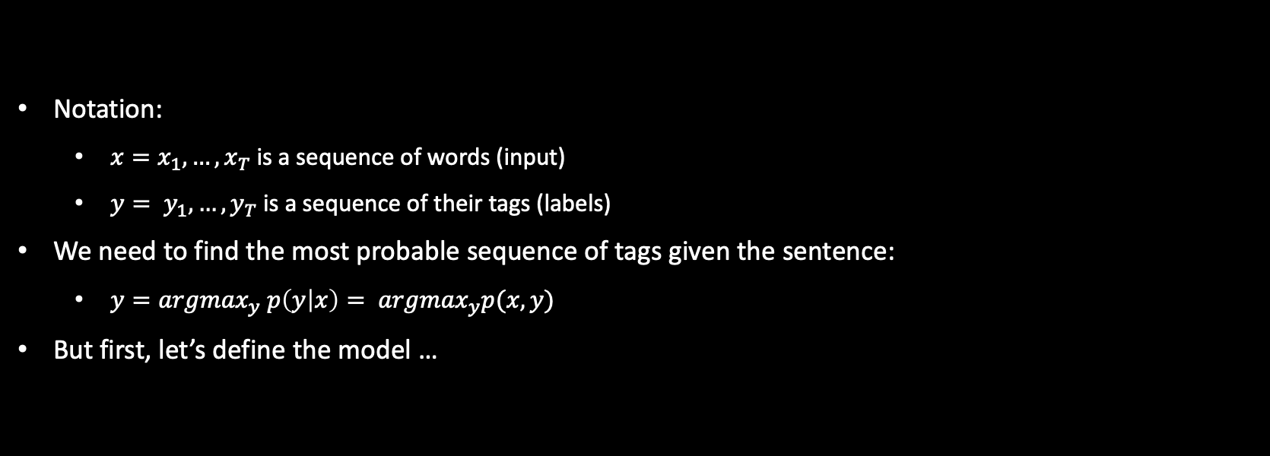
Pos tagging with hmms
Notation:
$x=x_{1}, …, x_{T}$ is a sequence of words (input)
$y= y_{1}, …, y_{T}$ is a sequence of their tags (labels)
We need to find the most probable sequence of tags given the sentence:
$y={argmax}_{y} p\left(y | x\right)= {argmax}_{y}p(x, y)$
But first, let’s define the model …
Notes:
to hidden Markov models,
let us define everything properly.
So please remember this notation,
and let us go through it.
So we have a sequence.
It will be a denoted by x,
and we have a sequence of tags,
which would be denoted by y.
The length of the sequence is big T,
and by T, we will denote the positions in our sequence.
Now, the task is to produce y given x,
to produce the most probable y.
So we need to find the most probable tags for our words in our model,
but to find something most probable,
we should first define the model and see what are the probabilities here.
So we are going to define the joint probability of x and y.
Do you understand the equation in the bottom of the slide?
So take a moment to see that, actually,
the right-hand side and the left-hand side can be both used to find
the argmax just because they are different just by probability of x,
which does not depend on y.
So if I multiply the left side by probability of x,
it is just constant for me.
So I don't care whether I do it or not

Slide 30
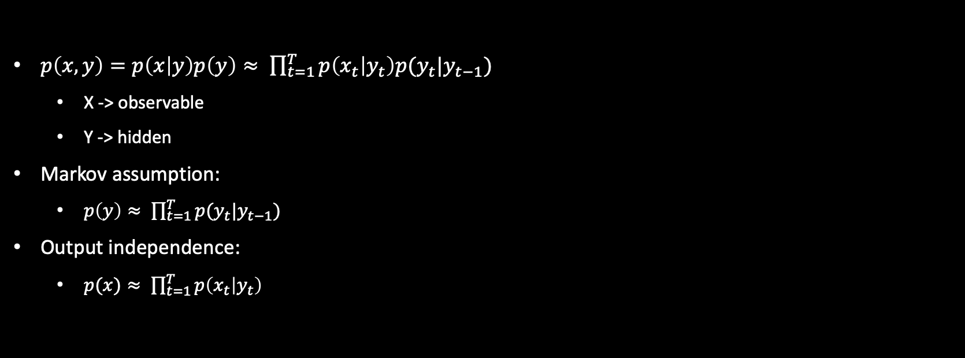
Hidden markov model
$p\left(x,y\right)=p\left(x | y\right)p\left(y\right)≈ \prod_{t=1}^{T}{p\left(x_{t} | y_{t}\right)p(y_{t}|y_{t−1})}$
X -> observable
Y -> hidden
Markov assumption:
$p\left(y\right)≈ \prod_{t=1}^{T}{p(y_{t}|y_{t−1})}$
Output independence:
$p(x)≈ \prod_{t=1}^{T}{p\left(x_{t} | y_{t}\right)}$
Notes:
Let us define the model.
This is probably the most important slide of our video
because it tells us what is the hidden Markov model.
So we need to produce the probabilities of x and y.
x are our observable variables and y are our hidden variables.
Now, first, we apply product rule to decompose it into two parts.
Then every part should be farther simplified,
and we can do this by applying two different assumptions.
The first assumption, which is called Markov assumption,
will help us to model the probability over the sequence of tags.
So we say that this sequence can be factorized into probabilities of
separate pieces so we just model
the probabilities of the next tag given the previous tag.
You have already seen this in the y-gram language models.
So there, we applied exactly the same formula to model the probabilities of words.
Now, we do this to model the probabilities of tags.
Also there, maybe you remember that we had to have
some special start token so that we could
write down this like that and be with the fact that we can have T equal to zero.
So, here, the first term would be the probability
of the first tag given some special zero tag,
which is just the start tag.
Awesome.
Now, the second assumption is about output probabilities.
So we need to produce the probabilities of x given y and it is rather complicated.
But we can say that we will factorize it into the probabilities for separate positions.
And for every position,
we will have the probability of the current word given the current tag.
So given these two assumptions,
you can write down the formula in the top of the slide.
And this is the definition of hidden Markov model

Slide 31
Text generation in hmm
Assume that the text is generated in the following manner:
One chooses the next PoS tag given the previous tag
Given the current tag, one generates another word
Thus, the neighboring words do not depend on each other, but they depend on the underlying tags.
Notes:
Now, hidden Markov model can be used to model texts.
So it can be used to generate texts.
Let us see how it happens.
So, first, we'll need to generate a sequence of tags,
and after that, we will generate some words given current tags.

Slide 32
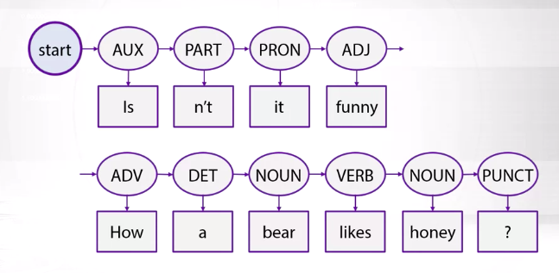
Text generation in HMM: an example
Notes:
For example, we will start with our fake start tag,
and then we'll generate some tags using those transition probabilities.
So we generate them and continue like that,
and after we are done,
we start to generate words given this tags.
So we generate a sequence,
and we see that the model has generated some nice example from Winnie The Pooh here.

Slide 33
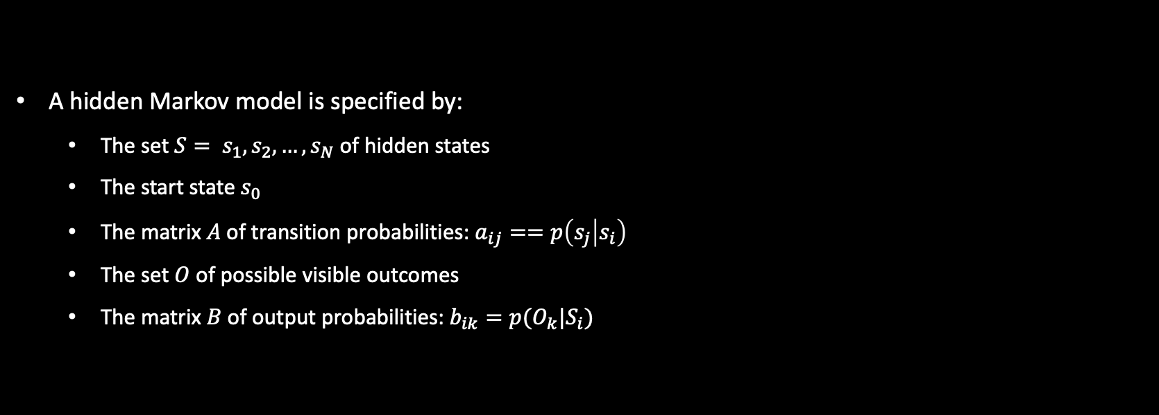
Formal definition of HMM
A hidden Markov model is specified by:
The set $S= s_{1}, s_{2}, …, s_{N}$ of hidden states
The start state $s_{0}$
The matrix $A$ of transition probabilities: $a_{ij}==p\left(s_{j} | s_{i}\right)$
The set $O$ of possible visible outcomes
The matrix $B$ of output probabilities: $b_{ik}=p(O_{k}|S_{i})$
Notes:
Now, let us define once again what are the parameters of the model.
So hidden Markov model is defined by the following formal five steps.
So, first, we have some hidden states,
those y in our previous notation.
We have some finite set of this states and also we have a special start state as zero.
We have transition probabilities that model the probabilities
of the next state given the previous one in our model.
Then we have some vocabulary of output words, and for them,
we have output probabilities,
so the probabilities of words given tags.

Slide 34
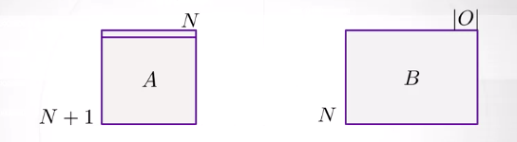
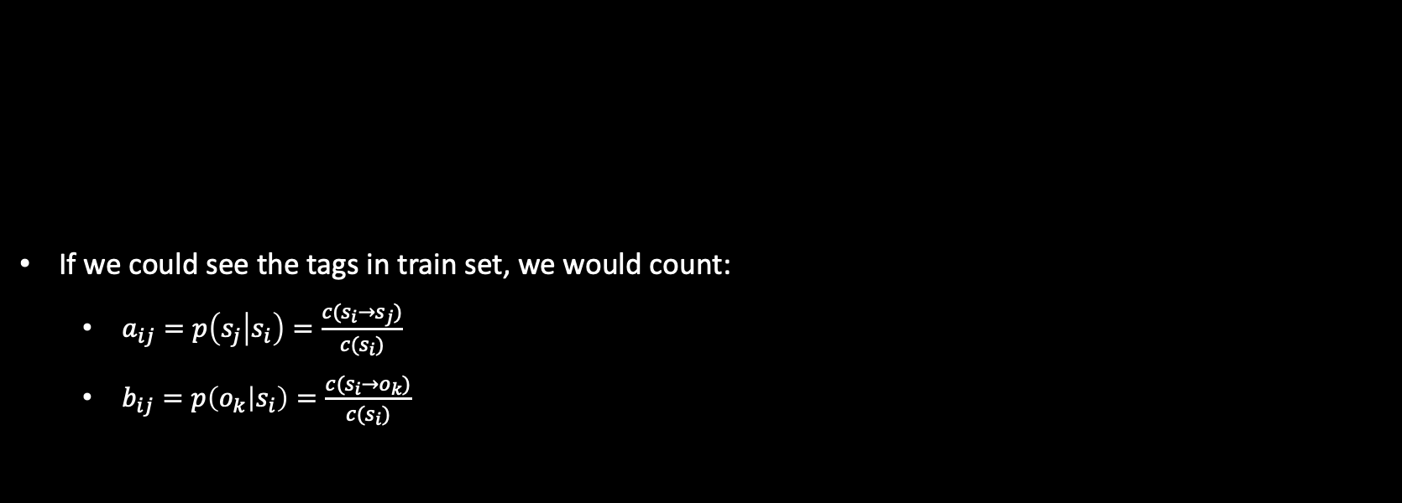
How to train the model?
If we could see the tags in train set, we would count:
$a_{ij}=p\left(s_{j} | s_{i}\right)=\frac{c(s_{i}→s_{j})}{c(s_{i})}$
$b_{ij}=p\left(o_{k} | s_{i}\right)=\frac{c(s_{i}→o_{k})}{c(s_{i})}$
Notes:
we have just two matrices of parameters.
A metrics is N plus one by N because you have also this special start token.
And for this special start state,
you need to model the probabilities to transit to all other states.
For the output probabilities,
the dimension will be the number of states multiplied by the number of output words.
So we have lots of parameters.
We need to learn them somehow.
So how can we train the model?
Well, let us imagine for now that we have a supervised training data set,
which means that we have a sequence of words,
and we have a sequence of tags for this words.
Then we could just count,
so we would count how many times we see the tag Si,
which is followed by the tag Sj.
And we will normalize this count by the number of times when we see the tag as i. So this way, we will get the conditional estimate to see the tag as j after the tag as i.
We could do the similar thing with output probabilities.
So there, we would count how many times some particular tag generates
some particular output and normalize this by
the number of times where we see this particular tag.
So this way, we would get conditional probabilities for the output words.

Slide 35
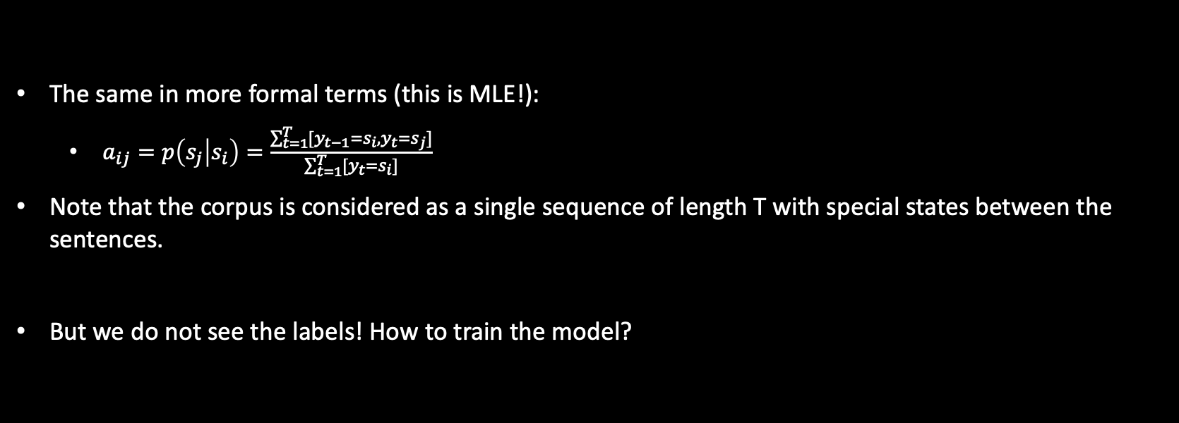
Supervised case: mle
The same in more formal terms (this is MLE!):
$a_{ij}=p\left(s_{j} | s_{i}\right)=\frac{\sum_{t=1}^{T}{[y_{t−1}=s_{i}, y_{t}=s_{j}]}}{\sum_{t=1}^{T}{[y_{t}=s_{i}]}}$
Note that the corpus is considered as a single sequence of length T with special states between the sentences.
But we do not see the labels! How to train the model?
Notes:
but let us get in a little bit more details and
make sure that we understand how we compute these counts.
So we have many sentences.
Let us just concatenate all those sentences into
one long corpus of the length big T. Then we can compute
those counts just by running through the corpus from T equal to one
to big T and computing the indicator functions.
So there, in green,
I write down that I see the tag Si on the position Yt minus one and then I
see the tag as j that follows and the similar indicator function in the denominator.
So this is still the same formula, just another Notation.
But the thing is that in real life,
usually, you do not have tags in your training data.
So the only thing that you'll see is plain text,
and you still need to train hidden Markov model somehow. How can you do it?
Well, obviously, you cannot estimate
those indicator functions because you don't see the tags of the positions,
but you could try to approximate those indicators by some probabilities

Slide 36
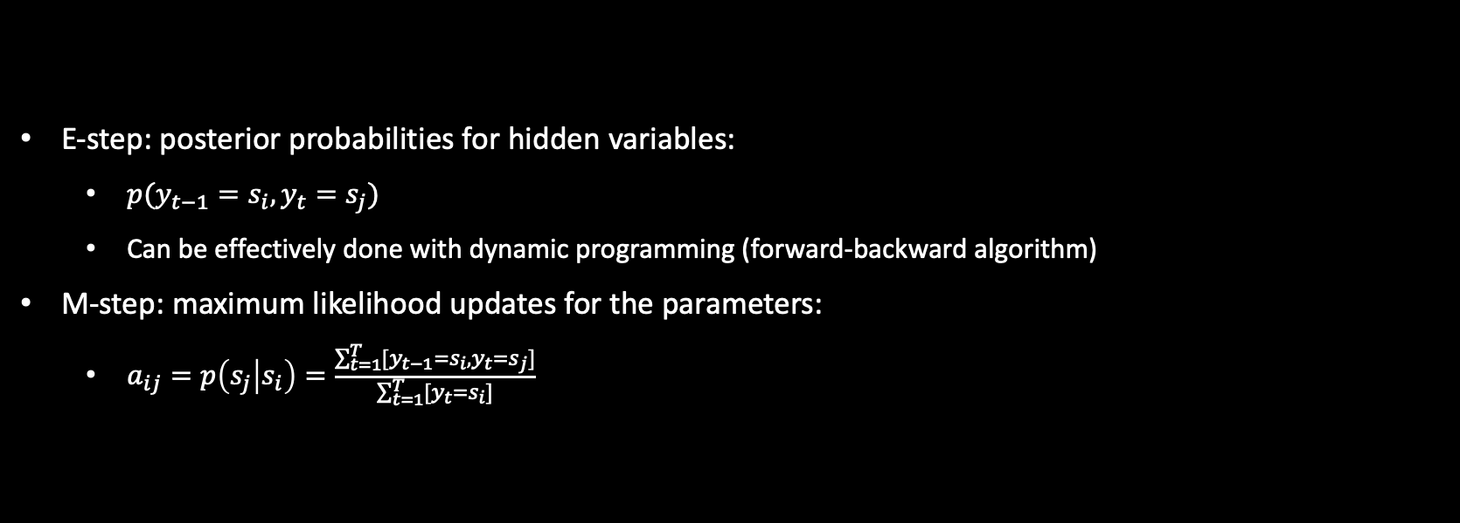
Baum-welch algorithm (a sketch)
E-step: posterior probabilities for hidden variables:
$p(y_{t−1}=s_{i}, y_{t}=s_{j})$
Can be effectively done with dynamic programming (forward-backward algorithm)
M-step: maximum likelihood updates for the parameters:
$a_{ij}=p\left(s_{j} | s_{i}\right)=\frac{\sum_{t=1}^{T}{[y_{t−1}=s_{i}, y_{t}=s_{j}]}}{\sum_{t=1}^{T}{[y_{t}=s_{i}]}}$
Notes:
So compare this formula with the formula in the bottom of this slide.
The only thing that has changed is that instead of indicators,
I have probabilities now.
So something in between zero and one,
but how can we get these probabilities?
Well, if they have some trained hidden Markov model,
we could try to apply it to our texts to produce those probabilities.
So the E-step in the top of this slide says that given some trained hidden Markov model,
we can produce the probability to see tags Si and
Sj in the position T. So this is something like three-dimensional array.
T, i, and j would be the indices,
and it can be actually done effectively with dynamic programming.
The only thing is that we need to have trained model there.
So the clever idea is to alternate two steps.
The E-step says that let us fix some current parameters of the Model A and B matrices
and use them to generate
those estimates for probabilities of tags for every certain position.
And M-step says let us fix those estimates and use them to update our parameters,
and those parameters updates are actually
still maximum likelihood estimates in this case.
So in the slide,
I have everything written down for A matrix,
but you can obviously do very similar things to compute B matrix.
So this is just a sketch of the algorithm it is called Baum-Welch algorithm.
And this is just a case over more general algorithm,
which is called EM algorithm,
and we will see this algorithm several times during our course every time when we
have some hidden variables that we do not see in
the training data and some observable variables.

Slide 37
Viterbi algorithm
What are the most probable tags?
Notes:
We talked HMM in yesterday’s class, We have briefly discussed how to train this model,
now how can we apply this to our texts?

Slide 38
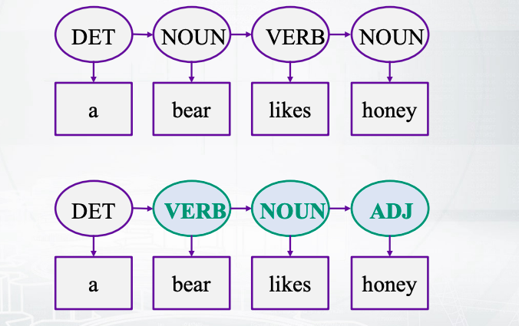
motivation
The same output sentence can be generated by different sequences of hidden states:
Notes:
This slide is just a motivation for
the next video, to show you that it is actually not that simple problem.
So for example, you can see a sequence of words, a bear likes honey, and
you can see that it can be decoded in different ways.
So the sequence of text in the top and in the bottom of the slides are both valid.
So both sequences could generate this piece of text, right?
This is because we have very ambiguous language.
For example, likes can be noun, or
verb, or something else maybe, if we think about it.

Slide 39
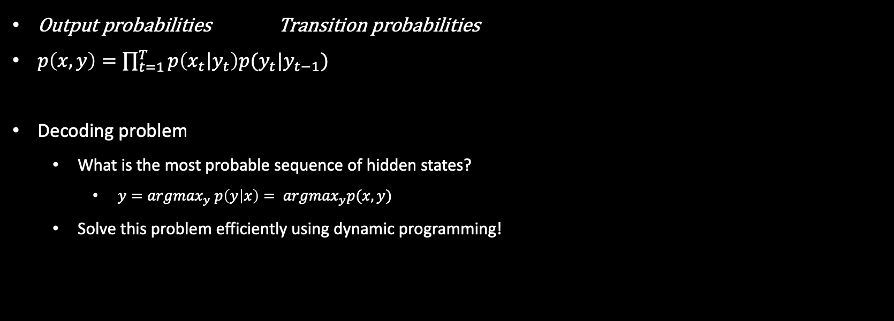
Decoding in hmm
Output probabilities Transition probabilities
$p\left(x,y\right)=\prod_{t=1}^{T}{p\left(x_{t} | y_{t}\right)p(y_{t}|y_{t−1})}$
Decoding problem
What is the most probable sequence of hidden states?
$y={argmax}_{y} p\left(y | x\right)= {argmax}_{y}p(x, y)$
Solve this problem efficiently using dynamic programming!
Notes:
Okay, then how can we generate the most
probable sequence of text given a piece of text?
This is called decoding problem, and this is formalized in the bottom of the slide.
So we need to find y which maximizes the probability of y given x.
And as we have briefly discussed, it would be the same as y
that maximizes the probability of both variables.
Now could we probably just compute the probabilities of
all ys, and then choose the best one?
Well not actually,
because this brute force approach would be really slow, right?
Or maybe not feasible at all,
because you have very many different sequences of text.
Let's say you have big T which is the length of the sentence, and
you have 10 possible states.
Then you will have T to the power of 10 different sequences, right?
So this is too much, but fortunately there is
an algorithm based on dynamic programming that can help us to do this effectively.

Slide 40
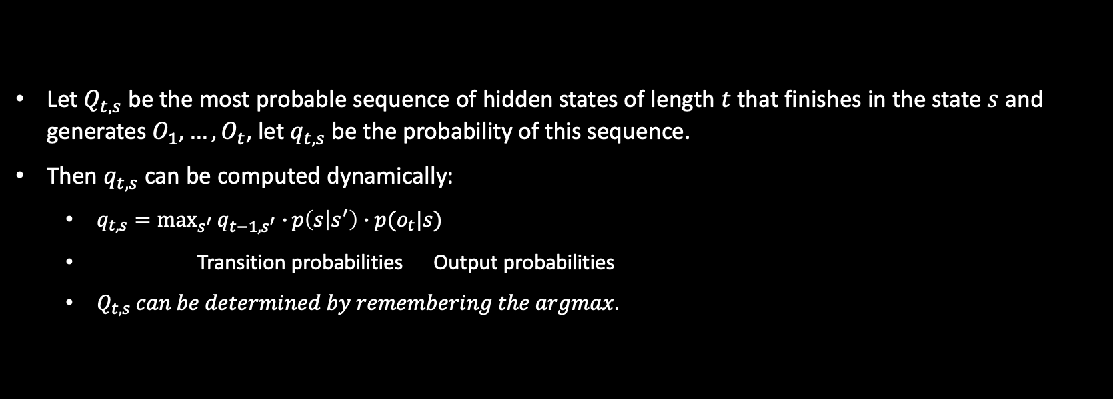
Viterbi decoding
Let $Q_{t,s}$ be the most probable sequence of hidden states of length $t$ that finishes in the state $s$ and generates $O_{1}, …, O_{t}$, let $q_{t,s}$ be the probability of this sequence.
Then $q_{t,s}$can be computed dynamically:
$q_{t,s}=\max_{s^{′}}{q_{t−1,s^{′}}∙}p\left(s | s^{′}\right)∙p(o_{t}|s)$
Transition probabilities Output probabilities
$Q_{t,s} can be determined by remembering the argmax.$
Notes:
We would like to find a sequence of text that is
the most probable to generate our output sentence.
However, we can do it straightforwardly.
So let us first start with finding the most probable sequences of text,
up to the moment t, that finishes in the state s.
So those big Qt,s things.
And let us denote by small qt,s the probabilities of those sequences.
Now, how can we compute those probabilities effectively?
We can say that once we have computed them for the time moment t-1,
we can use that to compute the next probabilities for the next time moment.
How do we do this?
Well we see that we have our transition probabilities and
output probabilities, as is said by the Hidden Markov Model.
And then we have these green qt-1 probabilities that hide the transition
probabilities and output probabilities for all the previous time moments.
Okay, and then we apply maximum because remember,
we are only interested in the most probable sequences.
Now when we compute these probabilities we are also interested
in the argmax, because the argmax will tell us
what are the states where these probabilities can be found.

Slide 41
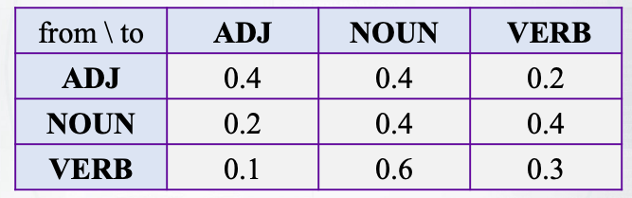
An example of hmm: transition probabilities
Suppose that we have the following PoS tags:
ADJ, NOUN, VERB.
Consider the transition probabilities between tags:
Note the the sum of probabilities in each row is equal to 1
Let all initial state probabilities be equal (to 1/3)
Notes:
Let us say that we have some Hidden Markov Model, and it is already trained for us.
So this is A matrix,
which has probabilities of some states given some other states, right?
Our transition probabilities.
Each row sums into 1, which means that we have indeed correct probabilities
So if you remember from the previous video,
we had also our special start state.
And we will need to have a special first row in this matrix that will
have the probabilities of some states given this special start state.
For now, let's say that this row is just filled with equal probabilities, so
it is just a uniform distribution.

Slide 42
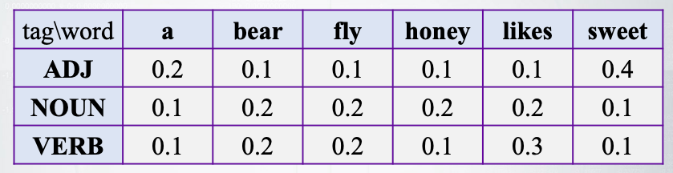
An example of hmm: output probabilities
Consider the3 following output probabilities for the vocabulary:
The probabilities in each row also sum to 1.
Notes:
we have this B matrix which tells us the probabilities
of the output tokens given some states

Slide 43
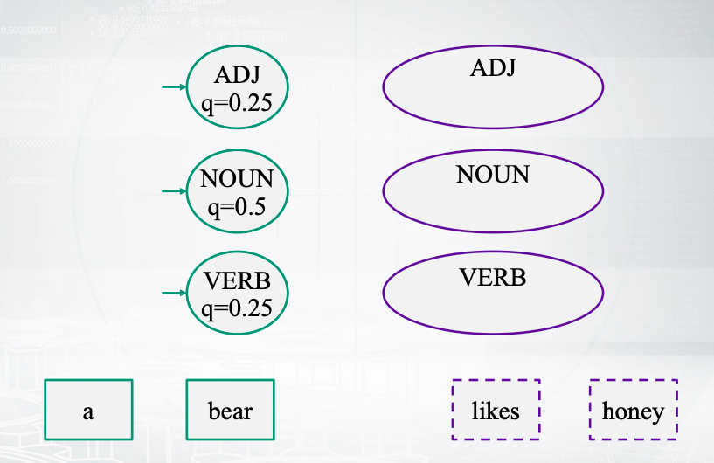
Probabilities of hidden states before “likes”
Notes:
Now how can we compute the probabilities for the next time moment?

Slide 44
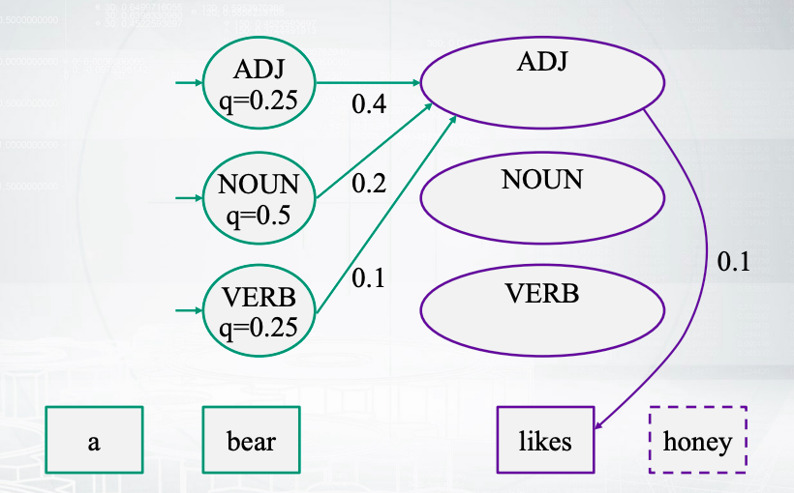
Possible transitions to adj state
Notes:
For the first state, for ADJ state,
we can try to go from different previous states.
And we have transition probabilities, different transition probabilities for
each of them.
And we have also the output probabilities to generate likes in this case.

Slide 45
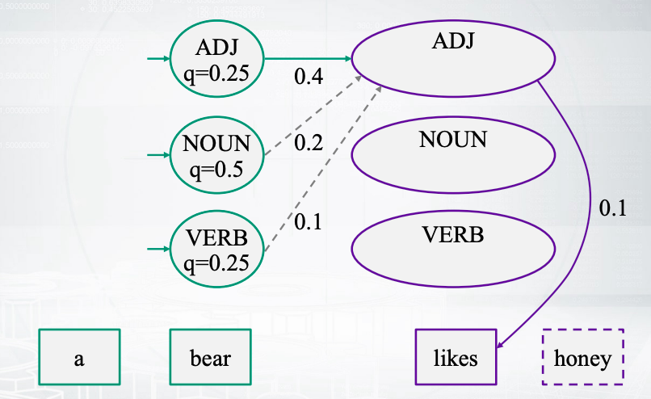
The best transition to adj

Slide 46
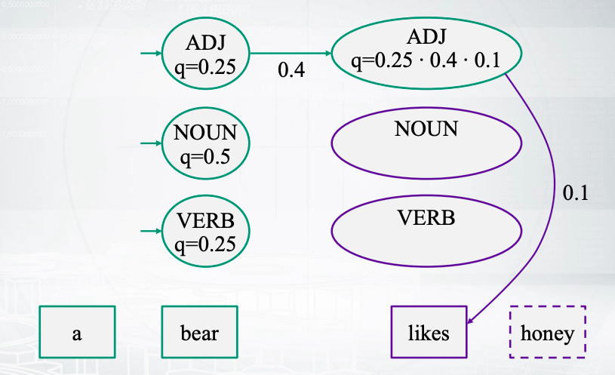
Probability of adj state given “likes”
Notes:
Now we need to find maximum, so we need to find the best way.
And in this case, it will be this one.
So we find this way, and
we say that the probability is now composed by three things.
The previous probability that we had so far, the transition probability, and
the output probability.

Slide 47
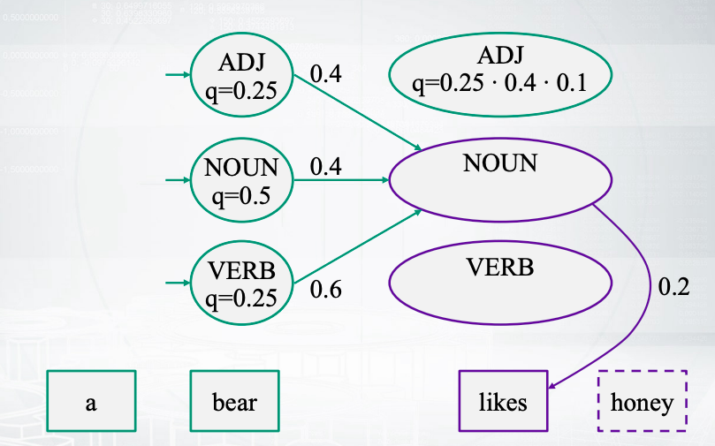
Possible transitions to noun state

Slide 48
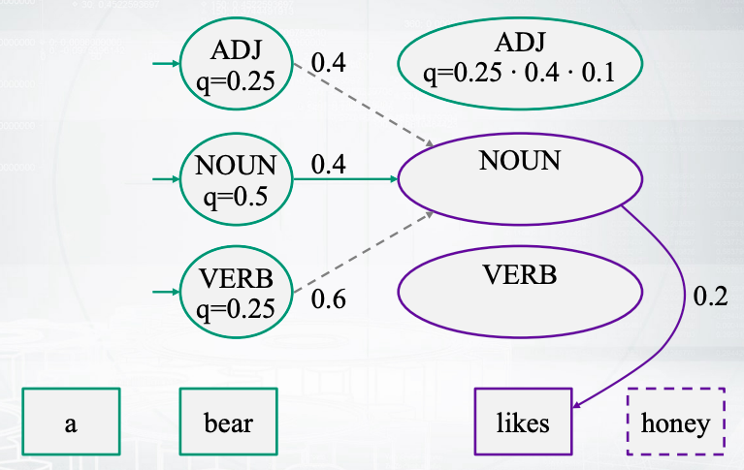
The best transition to noun

Slide 49
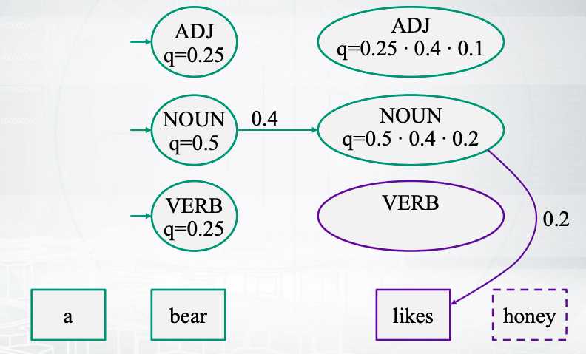
Probability of NOUN state given “likes”

Slide 50
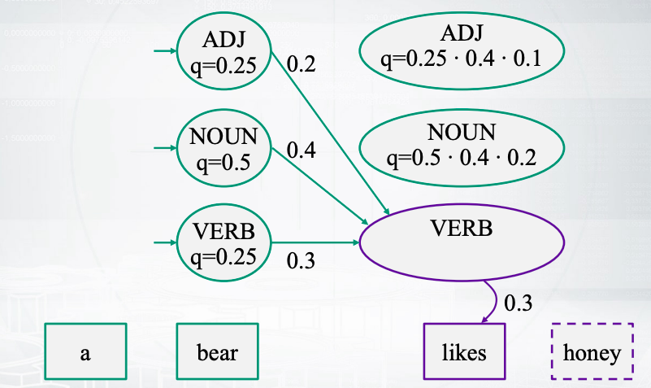
Possible transitions to VERB state

Slide 51
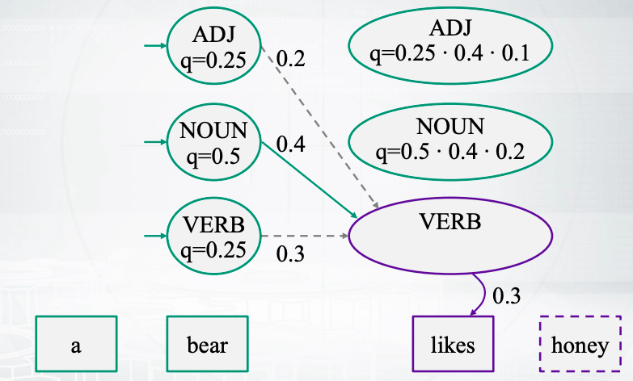
The best transition to VERB

Slide 52
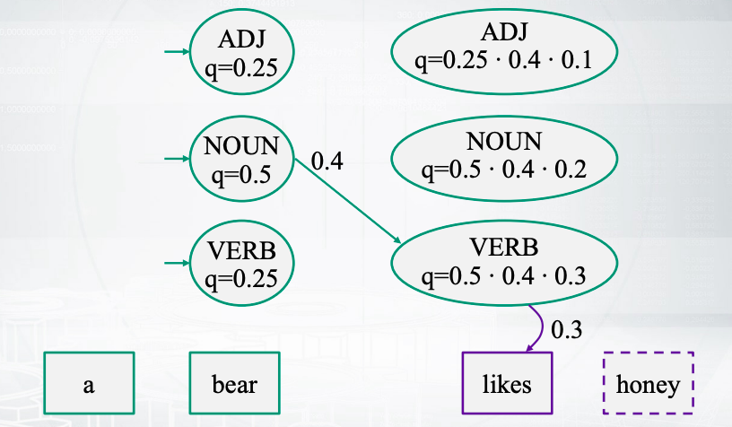
Probability of VERB state given “likes”

Slide 53
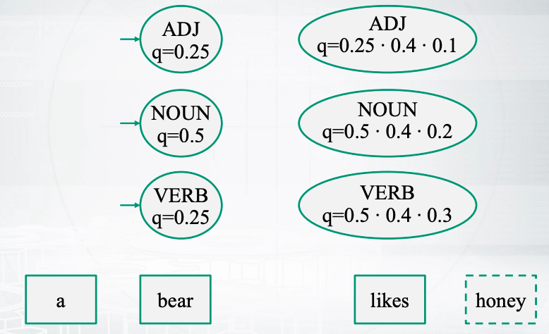
Probabilities of hidden states after “likes”

Slide 54
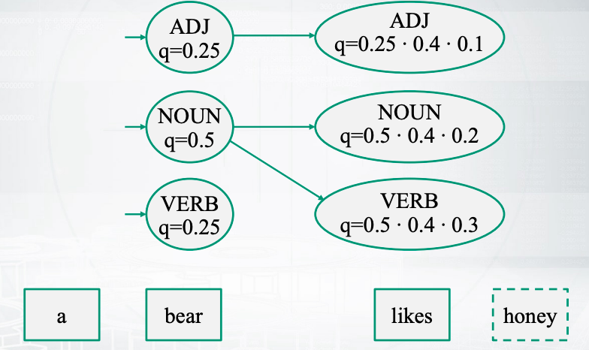
Remember the best transitions!

Slide 55
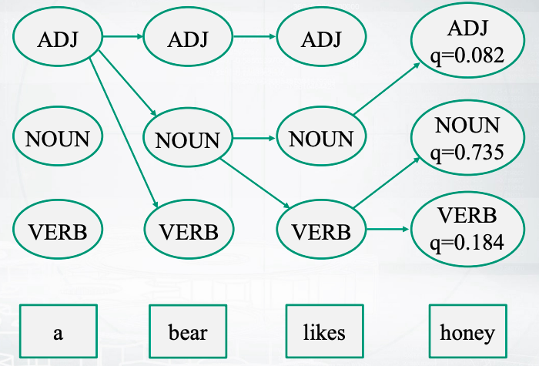
Backtrace

Slide 56
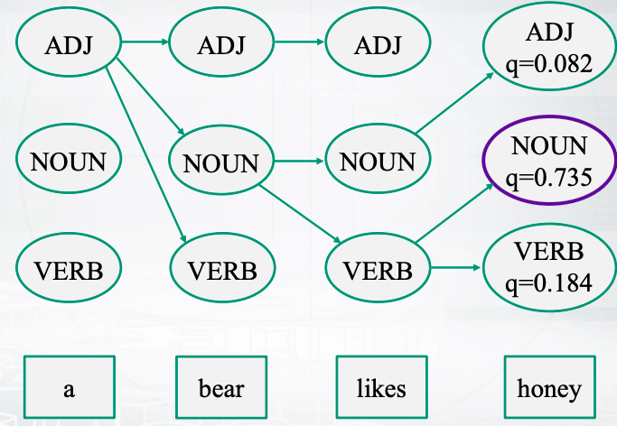
backtrace

Slide 57
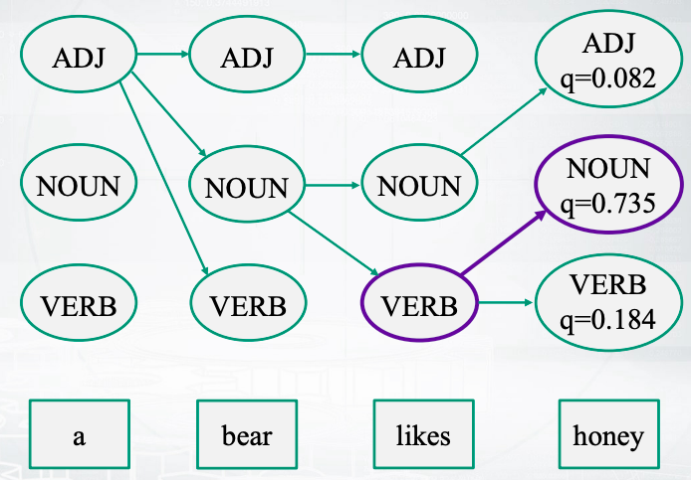
backtrace

Slide 58
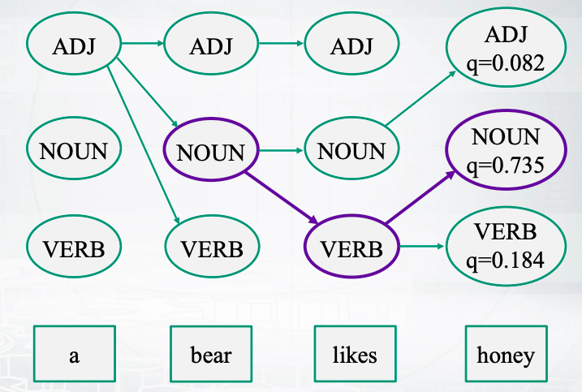
backtrace

Slide 59
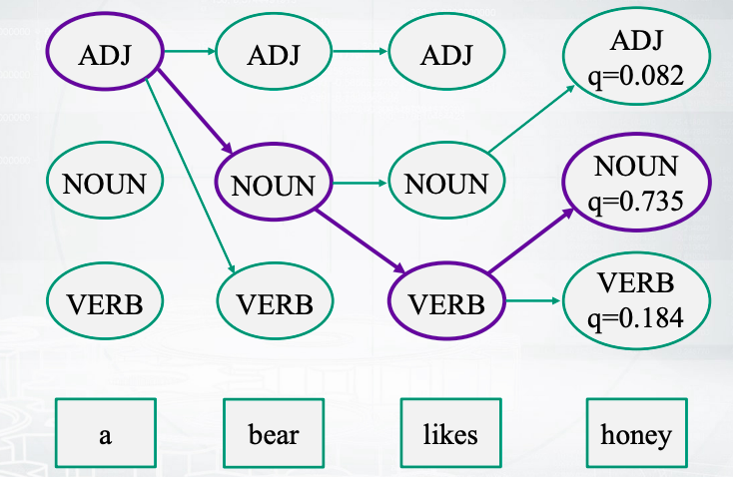
backtrace

Slide 60
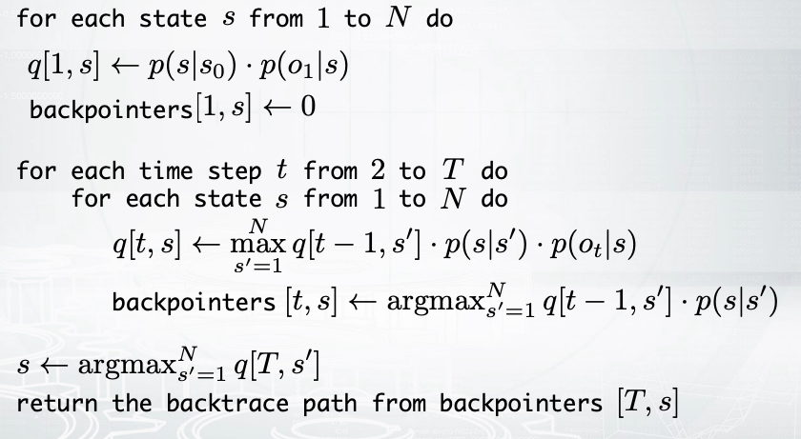
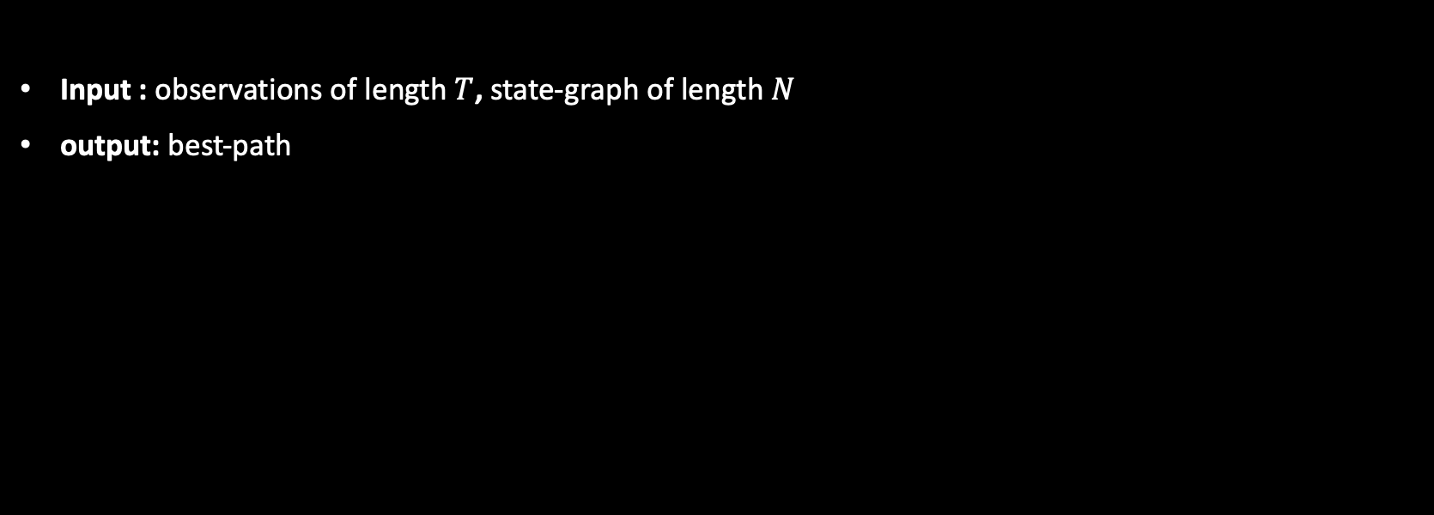
Viterbi algorithm
Input : observations of length $T$, state-graph of length $N$
output: best-path
Notes:
Awesome, we are done with the pictures.
This slide just summarizes everything that we have already said.
So to create your best path you need to first allocate an array
queue of the dimension the number of words in your sentence,
by the number of states in your model.
Then you need to fill the first column in your matrix, right?
So for the first time moment it is rather easy to compute the probabilities of
the states.
This would be just the probabilities to come to these states
from the initial start state,
multiplied by the probability to output the first word in this current state.
Now after that you have a loop.
So you go through all your positions in time, and you go through all your steps,
and compute those max values and argmax values.
After that you have your last column.
You apply argmax once again to find what would be the pick for
the last word in your sentence.
After that you backtrace all your text for the path.
And you are done, you get your best path.
So this is decoding in Hidden Markov Models.
And this is real useful, not only in part-of-speech tagging actually, but also,
for example, for some signals and other source of data where
you have different states that can generate some outputs.

Slide 61
MEMMS, crfs and other sequential models
For named entity recognition
Notes:
we will cover
several probabilistic graphical models for sequence tagging tasks.
You already know one of them.
So you know Hidden Markov models,
and you briefly know how to train and apply this.
In this video, we'll speak about few
more and we'll apply them to Named Entity Recognition,
which is a good example of sequence tagging tasks

Slide 62
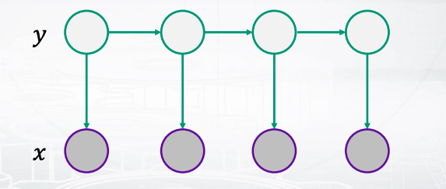
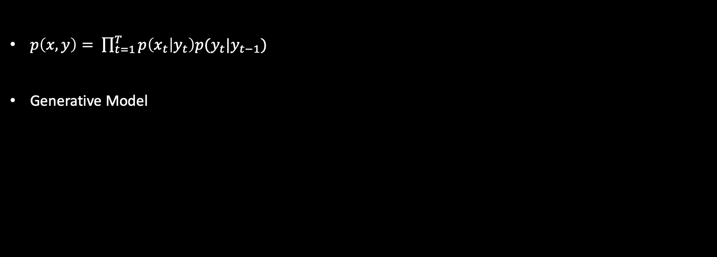
Hidden markov model
$p\left(x,y\right)= \prod_{t=1}^{T}{p\left(x_{t} | y_{t}\right)p(y_{t}|y_{t−1})}$
Generative Model
Notes:
this is a recap for hidden Markov model.
You maybe remember the formula,
and one important thing to tell you is that it is generative model,
which means that it models the joint probabilities of x and y.
And the picture in the bottom of the slide illustrates the formula.
So you see that every arrow is about some particular probability in the formula.
So we have transition probabilities going from one y to the next one,
and we have output probabilities that go to x variables.

Slide 63
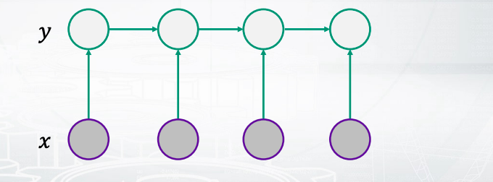

Hidden markov model
$p\left(x,y\right)= \prod_{t=1}^{T}{p(y_{t}|y_{t−1},x_{t})}$
Discriminative Model
Notes:
Now, another one would be Maximum Entropy Markov model.
Is a super similar.
So, do you see what is now different in the picture?
Only one thing has changed.
You have now the arrows going from x to ys.
Okay?
And in the formula,
we can see that now the factorization is a little bit different.
We have the probabilities of current tag given the previous tag,
and the current x.
What is also important is that this model is discriminative,
which means that it models the conditional probability of y given x.
So, it doesn't care to describe how the text can be generated.
It says that the text is observable and we just need to
produce the probabilities for our hidden variables, y.
Now, another important thing to mention is
that you see that it is factorized nicely still.
Right? So you have some separate probabilities,
and you have a product of this probabilities.
Let us look into more details how every probability can be written down.

Slide 64

Maximum Entropy Markov Model
$p\left(y_{t} | y_{t−1}, x_{t}\right)= \frac{1}{Z_{t}(y_{t−1}, x_{t})}exp⁡(\sum_{k−=1}^{K}{θ_{k}f_{k}(y_{t}, y_{t−1}, x_{t})})$
Normalization constant weight feature
Notes:
in this model,
every probability looks like that.
Maybe a little bit scaring but let us see what is here.
So, we have some exponents and we have some normalization constants.
So, this is actually just soft marks.
This is just soft marks applied to some brackets.
What do we see in the brackets?
We have there something linear.
We have weights multiplied by features.
So you can think about a vector of weights and the vector of features,
and you have a dot product.
Probably you have a feeling that you have
already seen something similar just in the machine learning.
So, do you remember a similar model?
Well, actually logistic regression is super similar to maximum entropy Markov model.
There, you also have a soft max applied to dot product of features and weights.
The only difference is that here,
you have rather complicated features that can depend on the next and the previous states.
So, the model knows about the sequence,
and it knows that the tags are not just separate.
Actually this feature is
a very interesting question because it is our job to generate these features somehow,
so we will get back to this question in a few slides.
But now, let us write down
one more probabilistic graphical model that can be even more powerful than that one.

Slide 65


Conditional Random Field (linear chain)
$p\left(y | x\right)=\frac{1}{Z(x)}\prod_{t=1}^{T}{exp\left(\sum_{k=1}^{K}{θ_{k}f_{k}(y_{t}, y_{t−1}, x_{t})}\right)}$
Undirected graph:
Notes:
This model is called conditional random field.
First, you can see that it is still discriminative model.
So it is the probability of y given x.
Now you can see that it is actually similar to the previous one, for example,
in the brackets, you'll still have these dot product of weights and features.
But what is the difference?
Do you see an important difference between CRF and maximum entropy Markov model?
The thing is that now you have only one normalization
constrain that goes outside of the product.
So you don't have any probabilities inside at all.
So, the model is not factorized into probabilities.
Instead, we have some product of some energy functions,
and then we normalize all of them to get the final probability.
And this normalization is actually complicated because,
well, we have many different sequences,
and we have to normalize in such a way that these
probability sums to one over all possible sequences of tags.
Now, when we depict this model with the graph,
it would be undirected graph.
So, I don't have any arrows at all.
I have just some links between the nodes.
And actually in this picture,
I write down a more specific case than the one in the top of the slide.
So here, in the top of the slide,
you can see that your features can depend on three things.
And here I kept them only for two things.
So I have one type of features about
transitions and another type of features about outputs

Slide 66


Conditional Random Field (general form)
$p\left(y | x\right)=\frac{1}{Z(x)}\prod_{a=1}^{A}{Ψ_{a}(y_{a}, x_{a})}$
Arbitrary factors
Notes:
Obviously, I could have something more complicated.
So, a general form of conditional random field would look like that.
So you have some arbitrary factors that depend
on some groups of y variables and x variables.
In the picture, these small green boxes would stand for different factors,
that you multiply them and then you normalize them and you get your probabilities.
So this is rather general model,
and maybe you are already lost with all those options.
So, if this is the case,
I have good news for you.
Probably, you will not need to implement this model
yourself because there are lots of black-box implementations for CRF model

Slide 67
Black-box implementations
CRF++: https://sourceforge.net/projects/crfpp/
MALLET: http://mallet.cs.umass.edu/
GRMM: http://mallet.cs.umass.edu/grmm/
CRFSuite: http://www.chokkan.org/software/crfsuite/
FACTORIE: http://www.factorie.cc/
Notes:
This is some links to checkout.

Slide 68

Features engineering
Label-observation features:
$f\left(y_{t},y_{t−1},x_{t}\right)=\left[y_{t}=y\right]g_{m}\left(x_{t}\right)$
$f\left(y_{t},y_{t−1},x_{t}\right)=\left[y_{t}=y\right]\left[y_{t−1}=y^{′}\right]$
$f\left(y_{t},y_{t−1},x_{t}\right)=\left[y_{t}=y\right]\left[y_{t−1}=y^{′}\right]g_{m}\left(x_{t}\right)$
Notes:
we have to do is we have to generate features to feed them into CRF models.
So, in the rest of the video,
we'll discuss how to generate those features.
From the formulas, you might remember that those "f" features can depend on three things;
the current tag, the previous tag,
and the current output.
Now, not to be overwhelmed with the variety of your features,
there is a very nice common technique which is called label observation features.
So, it says that you are only allowed to have these kind of features.
The observation part is about something that depends on the output.
So, we will go to this part,
and the green part,
the labeled part, is about indicators.
So you just check whether you have the current label equal to y,
and you check it for all possible labels.
Okay? So, it means that you have as many features as many labels you
have multiplied by the number of different observation functions that you invent.
And in the case of the second and the third line,
you will have even more features because there,
you check these indicators for the current and for the previous tags.
So, we are going to have lots of them.
Now, how those observation parts will look like

Slide 69

Observation function examples
Notes:
This is just some example taken from the paper,
and it says that you can be as creative as you want.
So, first, you can check that your current word is equal to some predefined word.
And you can check it for all the words in the vocabulary.
So again, you will have let's say plus 100,000 features just by the first line.
Then, you may want to check your part-of-speech tag for
the current word defined by some extrinsic part-of-speech tager,
and you will have again many features,
many binary features here that tell you whether your tag is equal to
noun or whether it is equal to a verb and so on and so on for all possible tags.
And you can have lots of other ways to define your features.
For example, you can check whether your word is capitalized,
or whether it has a dash in the middle,
or whether it consists only from capital letters,
or whether it appears in some predefined list of
stop words or predefined list of some names.
So, actually this is how your work would look like if
you decided to use CRF for some sequence tagging task.
You would take some implementation and you would generate
as many useful features as you can think about

Slide 70


Dependencies on input
Trick: Pretend the current input $x_{t}$contains not only the current word $w_{t}$, but also $w_{t−1}$ and $w_{t+1}$and build observation functions for them as well.
The model is discriminative, so we can use the whole input:
Notes:
Now, one trick that I want to mention here is that even
though we say that the feature can depend only on the current output,
x_t, well, it is not like that.
So, honestly, we can put into this x_t everything that we want.
For example, we can say that our current x_t consists of the current word,
the previous word and the next word,
and with have features for all of them.
So, you should multiply those tremendous number of
features by three right now. And it is okay.
So, the model will not break down just because it is discriminative model.
So, we do not care about modeling the sequence of
x which means that we can do whatever we want basically.
So, this picture depicts this idea and it says that
every feature can actually have access to all words in our sentence.
It can be a little bit messy.
So, just be prepared that it happens and people think that this is okay and this is nice,
and this is how it works actually

Slide 71
Resume for the lesson
Probabilistic graphical models:
Hidden Markov Models (generative, directed)
Maximum Entropy Markov Models (discriminative, directed)
Conditional Random Field (discriminative, undirected)
Tasks:
Training – fit parameters (Baum-Welch for HMM)
Decoding – find the most probable tags (Viterbi for HMM)
Practice:
Features engineering + black-box implementation
Notes:
So, just to sum up what we have discussed.
Well, we have discussed different graphical models for sequence tagging.
We have discussed one of them,
Hidden Markov model with more details.
So, we have seen how to train this model and how to do decoding in this model.
And in practice, usually you will need just to do feature generation,
and use some implementation of one of this model.
So, this is all for probabilistic approach for sequence tagging,
but we will also discuss neural networks for this task later.

